Slide 1
Cruise Ship
Group Members:
Kyle | Tao Zhang
Rui Zhou | Daqing Cao
Patricia Konney | Xiaoke Xu

Slide 2
Outline
Project Purpose
Target Customers
Website Design
Site Map
Marketing Approach
Search Marketing & Social Media Approach
Time Frame

Slide 3
Project Purpose
Know more about ocean creatures
Present the OTN data in an interesting way
Bring interesting and relaxing experience

Slide 4








Target Customers
Students
Parents with children
Old people
Single or couple
Travel Agencies
Everyone who want enjoy an interesting ocean trip

Slide 5
Website Design --Website Structure Design
Website Name
Labels
Home + foods + Route + Ticket + Contact
Programing language: PHP
Flow chart

Slide 6
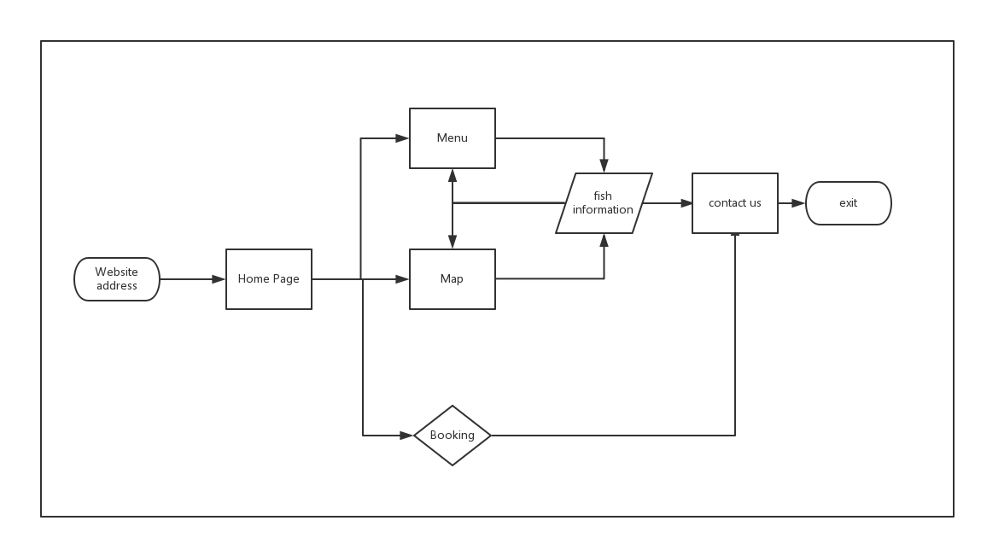
Website Design --Website Structure Design
User Flow

Slide 7
Website Design --Website Images Design

